Slide 1

WEEK 9 SOLID TEAM REPORT
BATCH 2

Slide 2
WEEKLY OBJECTIVES
FINISH UP
FINISH UP ON THE 2 GRAIN MOTOR.
COOK
COOK 2 FULL GRAINS.
CONDUCT
CONDUCT STATIC TEST.

Slide 3
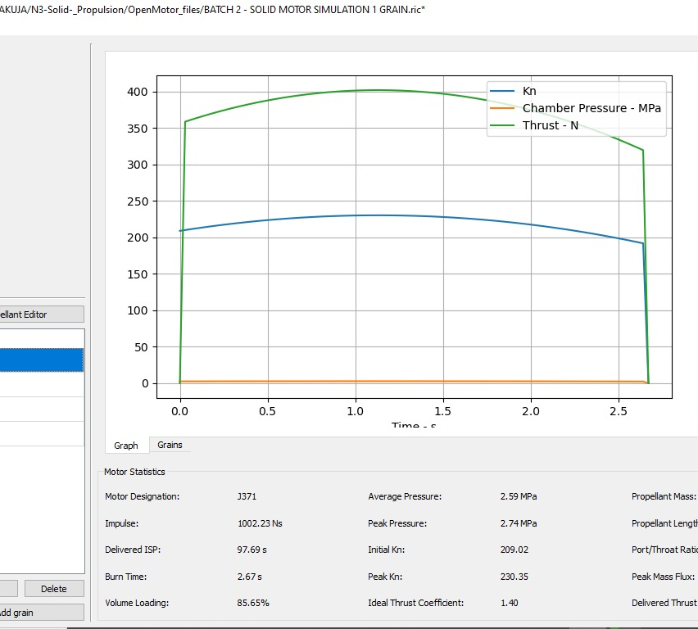
SIMULATION OF TWO GRAIN MOTOR

Slide 4
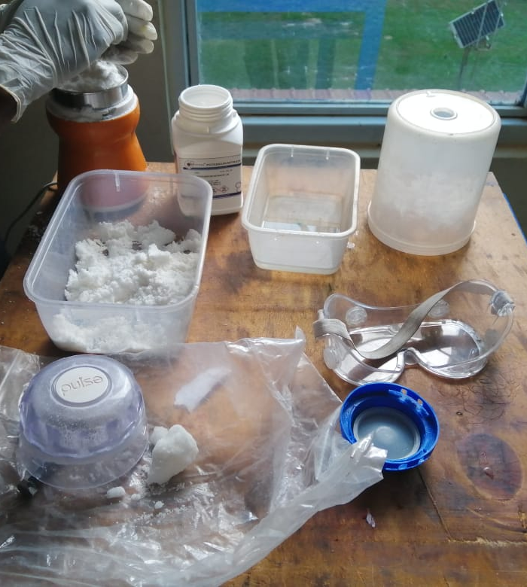
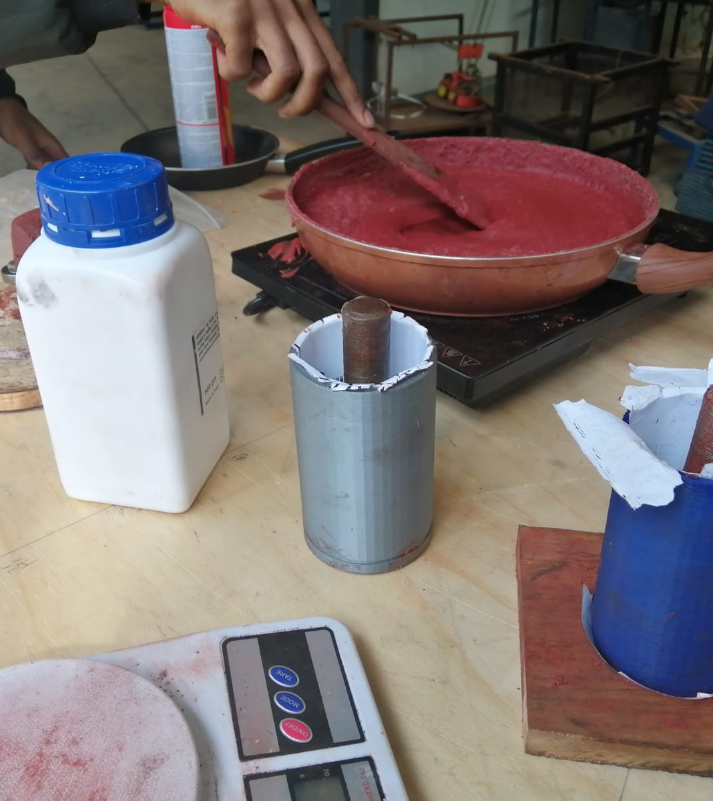
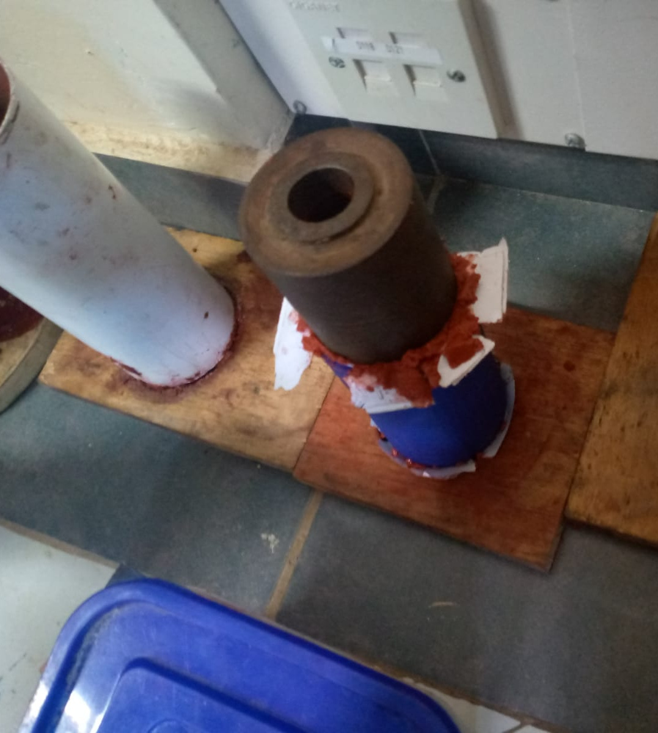
COOKING TWO GRAINS

Slide 5
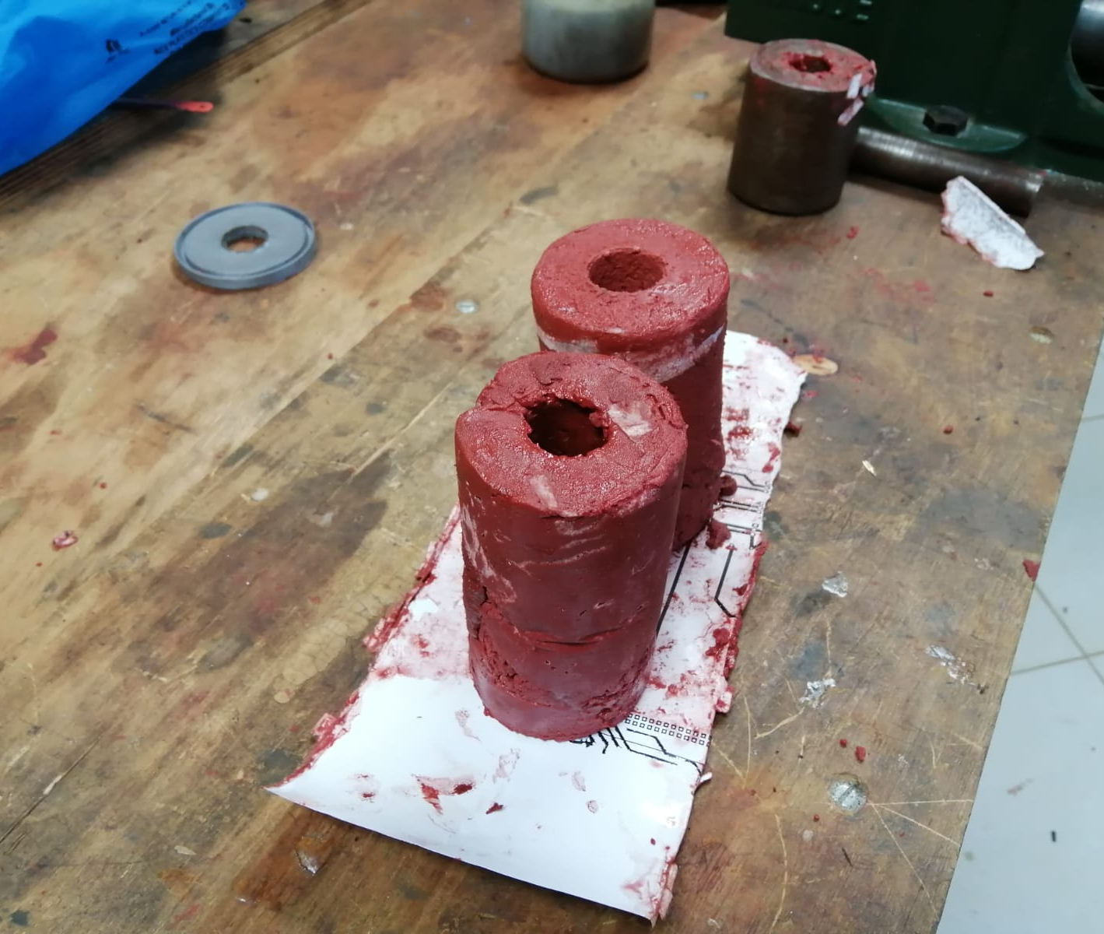
FINAL PRODUCT

Slide 6
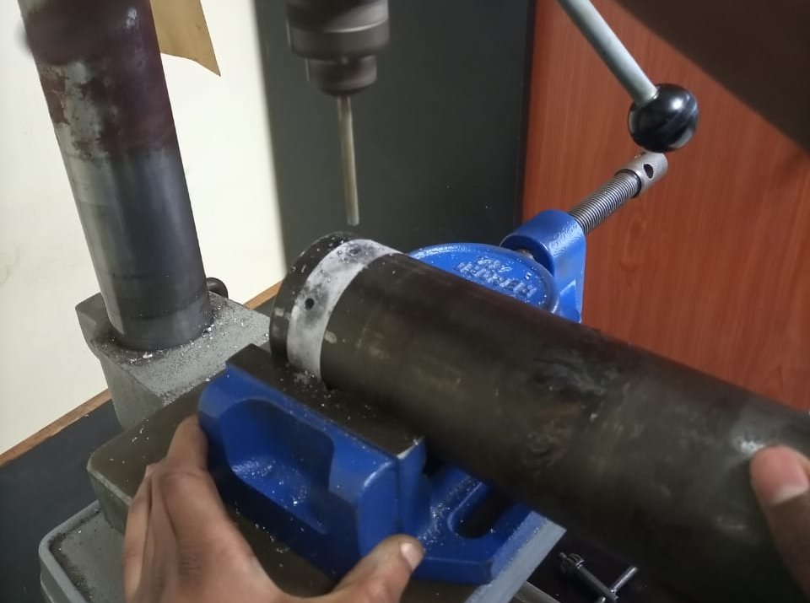
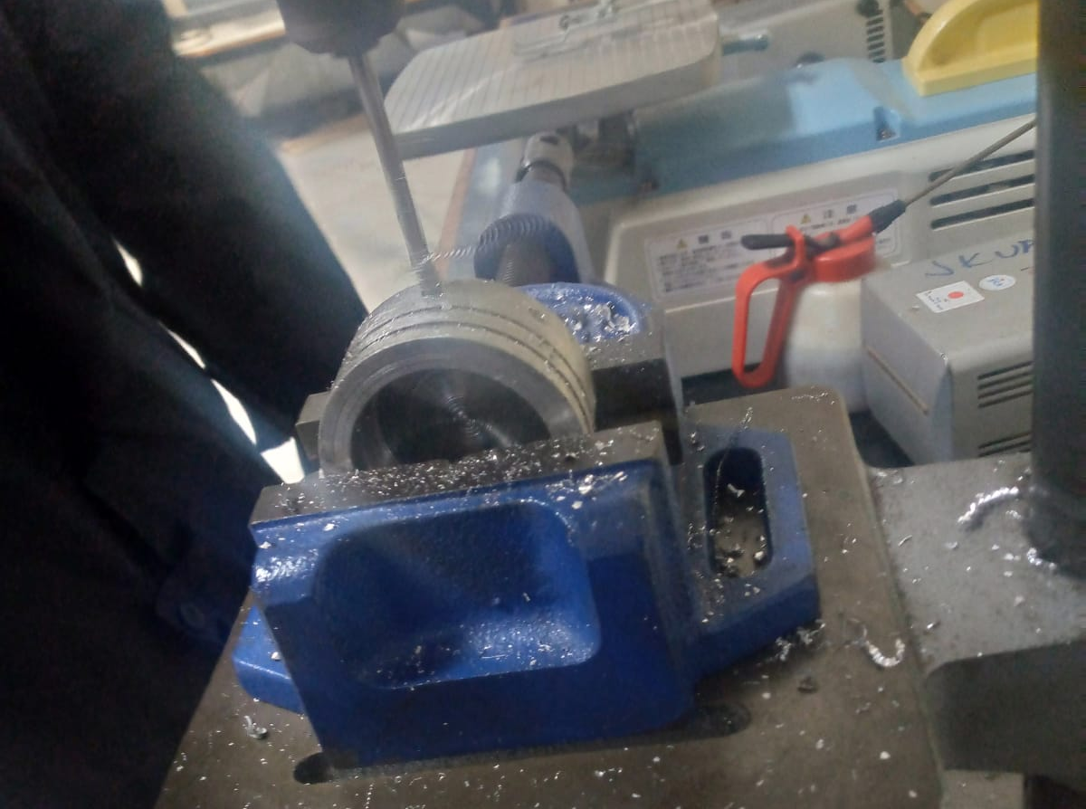
DRILLING OF BULKHEAD AND CASING

Slide 7
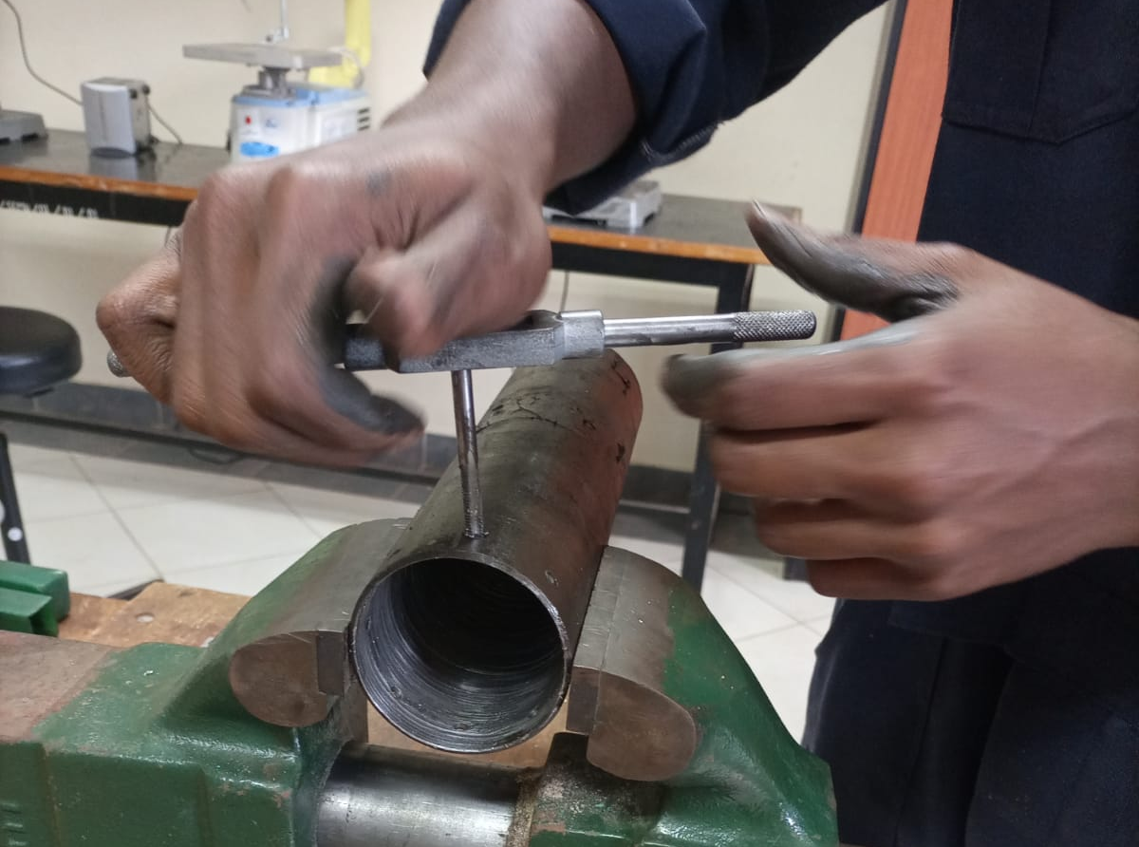
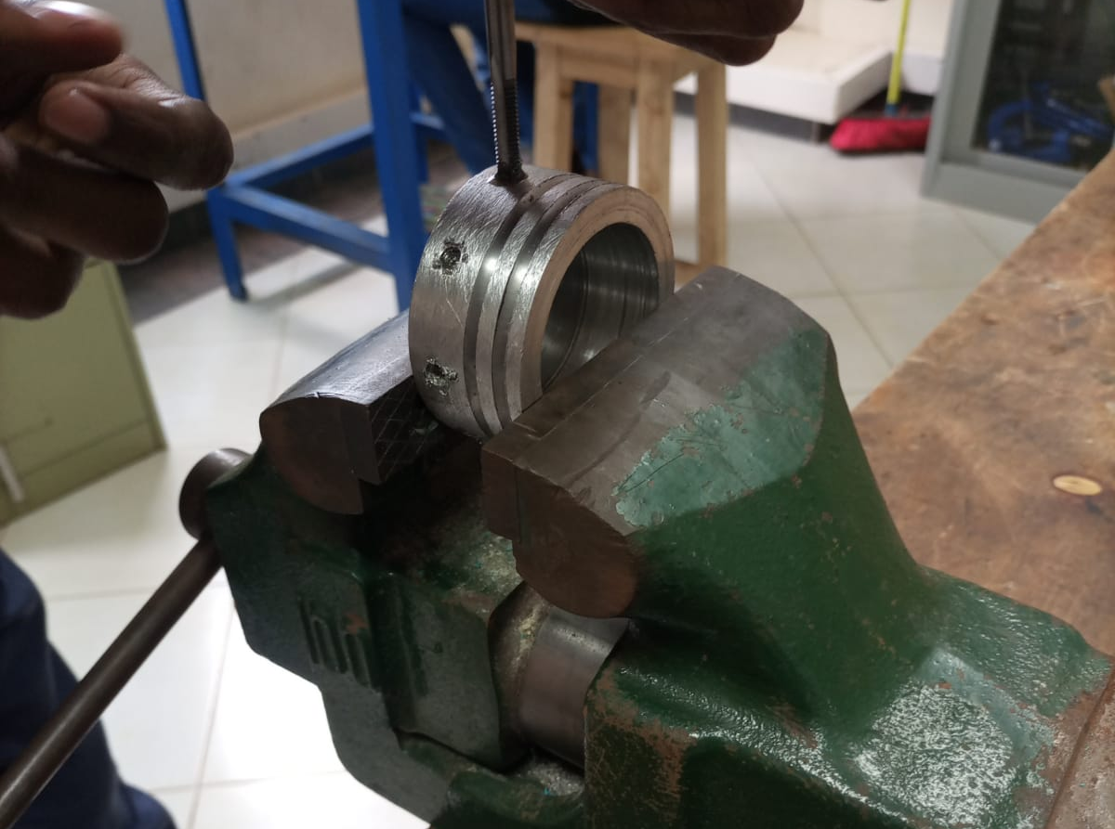
TAPPING OF BULKHEAD AND CASING

Slide 8
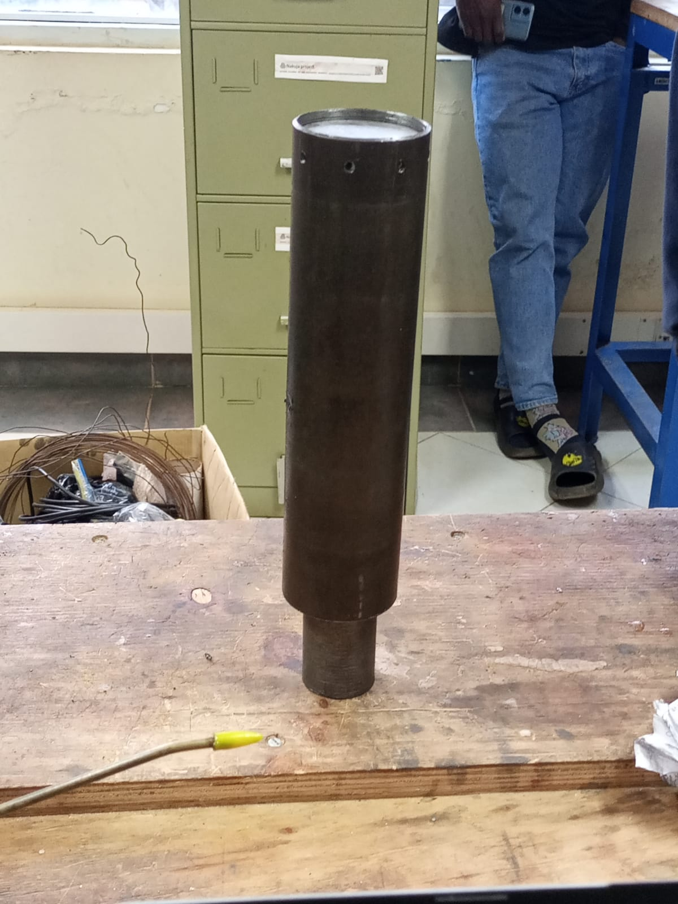
ASSEMBLY

Slide 9
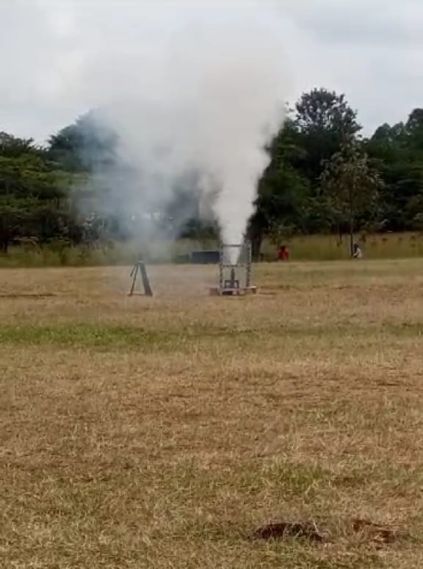
STATIC TEST
https://photos.google.com/share/AF1QipPy1zYaDyku8yvup7_9s7e2EUUXyLsp6BuL0e7tGyP1ksXkVun3unHOr58JC0QGWQ/photo/AF1QipMpY0uJvHiwtVLpGcDX913BXv2ZJIp-a-Eqessq?key=WlFMZ3hRMG85ekpiRjhKQWlCdHdqNVAyV0pnYUt3

Slide 10
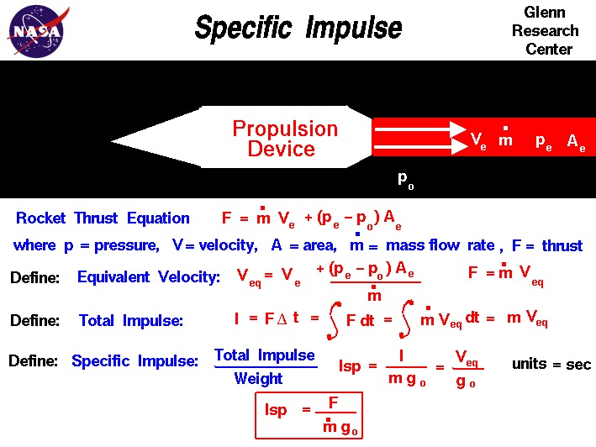
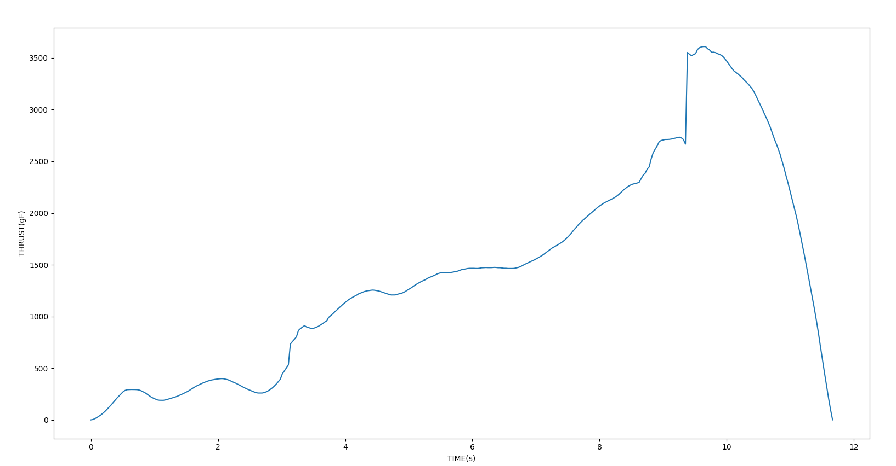
RESULTS
Total impulse generated was 169Ns

Slide 11
CHALLENGES
GRAINS USED DID NOT DRY

Slide 12
NEXT WEEK’S OBJECTIVES
COOK 2 GRAINS FOR SCRATCH
REDESIGN CASING FOR ELECTRONICS
FINISHING UP ON DESICCATOR
PREPARE TWO GRAIN MOTOR FOR SECOND TEST

Slide 13

THANK YOU

